Slide 1
Maths at Mill Rythe Junior School
Parent Workshops Autumn Term 2025

Slide 2
What Maths do we do?
Daily 1 hour maths lessons-covering all aspects of the maths national curriculum
Followed by a daily, 20 minute additional maths session;
  Mon: KIRF Session for all year groups
  Tues, Wed, Thurs: Times Tables Workshops for Years 3 and 4
  Fluency Session for Years 5 and 6

Slide 3
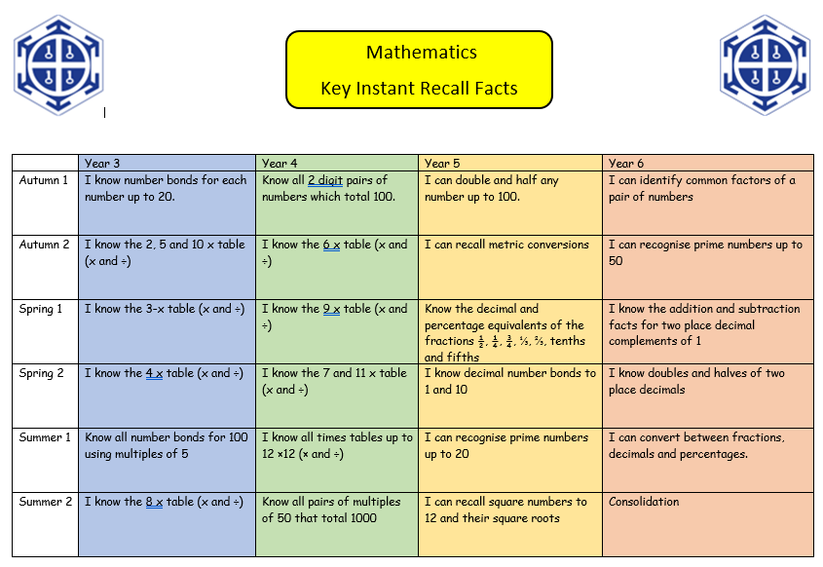
KIRFs (Key Instant Recall Facts)

Slide 4
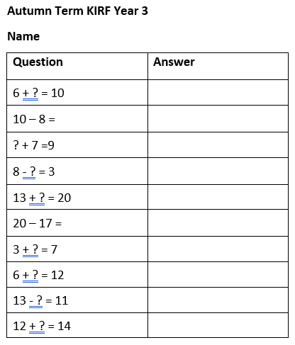
How will we measure impact?
The children will see how many they can get in 2 minutes at the start, and then again at the end of the half term.

Slide 5
Fluency Sessions
These are revision sessions of prior learning in order to help learning ‘stick’ into children’s long term memory
Children work through 5 slides;
  Times tables
  Four operations check
  Fractions (and/or decimals and percentages in upper school)
  Elegance-how efficiently can you solve a problem? What’s the best method?
  Another slide based on an area of identified need

Slide 6
Times Tables Workshops (Lower School)
Counting stick
Drawing a picture/using resources to represent a multiplication fact
Flash cards in pairs
Other fun and interactive games!
Timed online test (MTC simulation)
Knowing your times tables means knowing the related division facts too!

Slide 7
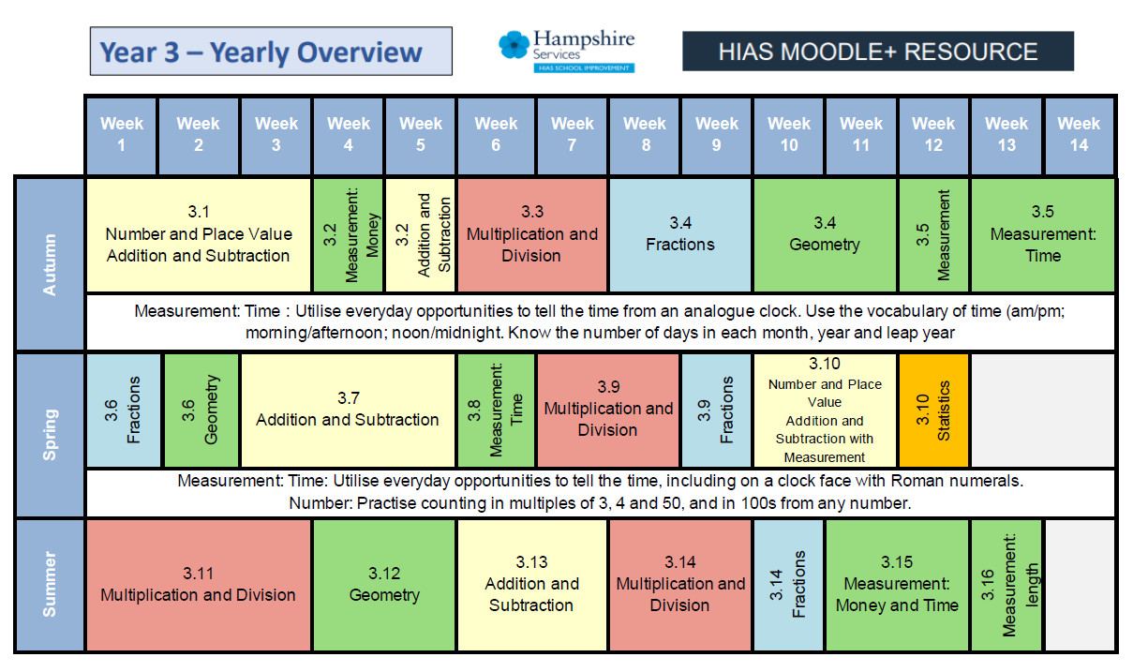
Hampshire Schemes of Learning

Slide 8
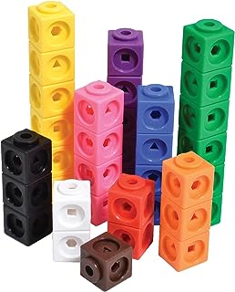
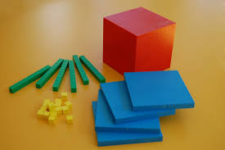
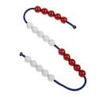
The CPA approach
The Concrete Pictorial Abstract (CPA) approach is a system of learning that uses physical and visual aids to build a child’s understanding of abstract topics.
Concrete-KS1 and early KS2 but can continue further up where needed. Children use practical objects to help count and calculate, for example buttons, Dienes, counters, multi-link, real life objects, bead-strings, fraction tiles, Numicon etc
Pictorial-children draw pictures and jottings to help them. E.g. dots to share out when dividing or bar models to draw out the problem
Abstract-children use just the numbers and symbols
Notes:
We follow the CPA approach. Pupils will use concrete objects to help to develop a conceptual understanding of a problem so that they are really understanding what’s going on behind the question and don’t just learn it on a superficial level. E.g. knowing that 5 x 6 is actually 5 groups of 6 and being able to use counters to show this.
While it is probably true that concrete resources are used more widely in lower school, they are also used in upper school as well as abstract methods being used on lower school. We try to use the CPA stages simultaneously alongside each other so that pupils see all 3 together.

Slide 9
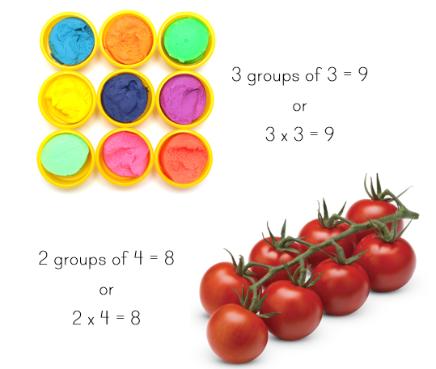
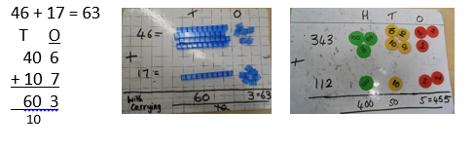
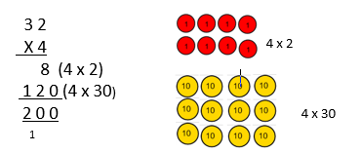
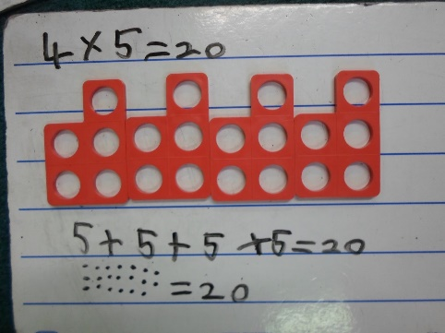
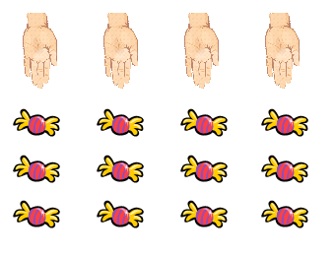
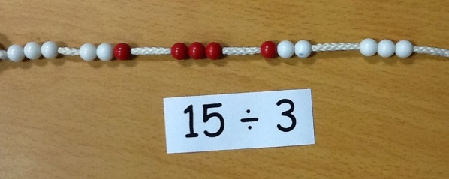
Concrete and Pictorial

Slide 10
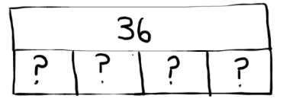
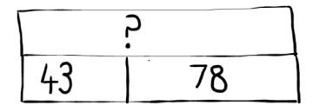
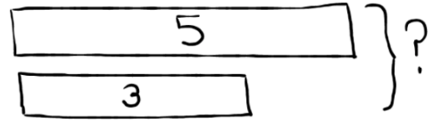
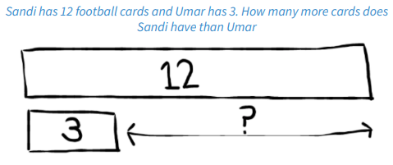
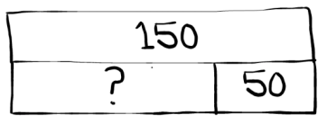
Bar Models
36 ÷ 4 = ? or 4 x ? = 36
43 + 78 = ?
3 + ? = 5 or 5 = ? = 3
150 - 50 = ?

Slide 11
Bar Models for fractions of amounts
Finding fractions of amounts e.g. Find 3/5 of 20
Jake is finding fractions of an amount. He knows that 1/5 of a number is 8. What is the number?

Slide 12
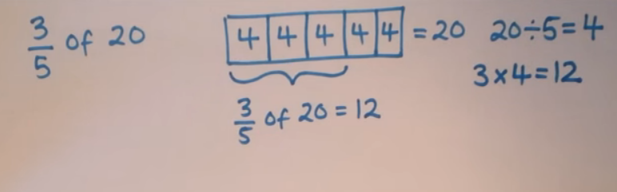
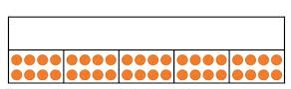
Bar Models for fractions of amounts
Jake is finding fractions of an amount. He knows that 1/5 of a number is 8. What is the number?

Slide 13
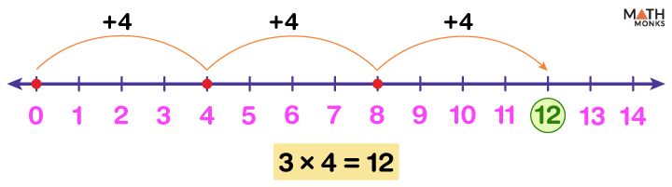
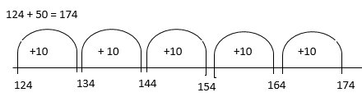
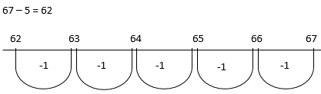
Number Lines

Slide 14
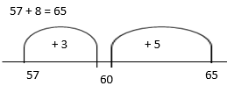
Partitioning on a number line
Pupils use their bridging skills from KS1 to add on mentally
8 has been partitioned into 3 and 5 to reach the next multiple of 10 first.

Slide 15
Expanded and Compact Methods (+, - and x)
Expanded Methods
357 + 285
300 50 7 357
+ 200 80 5 + 285
10 2 or 12
100 30 0 130
500 0 0 500
600 40 2 642
Compact Methods
357 + 285
357
+ 285
642
1 1
http://www.millrythejunior.co.uk/maths-video-links/

Slide 16
Expanded and Compact Methods (+ - and x)
Expanded Methods
876 – 214 = 562
800 70 6 8 7 6
- 200 10 4 - 2 1 4
2 or 2
60 6 0
600 6 0 0
600 60 2 6 6 2
Compact Methods
876 - 214
8 7 6
- 2 1 4
6 6 2
http://www.millrythejunior.co.uk/maths-video-links/

Slide 17
Expanded and Compact Methods (+ - and x)
Expanded Methods
42 x 54
4 2
x 5 4
8 (4 x 2)
1 6 0 (4 x 40)
1 0 0 (50 x 2)
2 0 0 0 (50 x 40)
2 2 6 8
Compact Methods
42 x 54
4 2
x 5 4
1 6 8
2 1 0 0
2 2 6 8
http://www.millrythejunior.co.uk/maths-video-links/

Slide 18
Division
Chunking
3 5
24 7814 0
- 4 8 0 (20)
3 6 0
- 2 4 0 (10)
1 2 0
- 1 2 0 (5)
0
Fact Box
24 x 10 = 240
24 x 20 = 480
24 x 5 = 120
24 x 2 = 48
Short Division
864 ÷ 4
216
4 86²4
574 ÷ 3
1 9 1 r 1
3 5²74
http://www.millrythejunior.co.uk/maths-video-links/

Slide 19
How can you help?
Practise at home with a ‘little and often’ approach.
Practise the KIRFs, times tables facts, number bond pairs etc regularly-anywhere and everywhere! In the car, in the bath, walking the dog!
Remember, KIRFs are ‘Instant’ recall-being able to work out the answer in a few seconds is not instant recall, so work on the speed and accuracy.
Make it fun! Use a timer to see if they can improve their time to answer 10 questions, or the amount they can recall in a given time.
Years 3 and 4 especially-please support them to learn their times tables! By the end of Year 4, they are expected to know all times tables up to 12 x 12.
Support with homework.

Slide 20
Useful websites
Hit the Button- https://www.topmarks.co.uk/maths-games/hit-the-button
Snappy Maths http://www.snappymaths.com/multiplication/multiplication.htm
Time table games: https://www.timestables.co.uk/games/
Maths frame: https://mathsframe.co.uk/en/resources/resource/477/Multiplication-Tables-Check
TT Rockstars: https://ttrockstars.com/
BBC Bitesize: https://www.bbc.co.uk/bitesize/subjects/z826n39

Slide 21
Our New Curriculum
We follow Hampshire’s schemes of learning which tell us what to teach and when.

Slide 22
Cyclical curriculum-we visit the same topic 2-3 times throughout the year, building on previous learning.

Slide 23
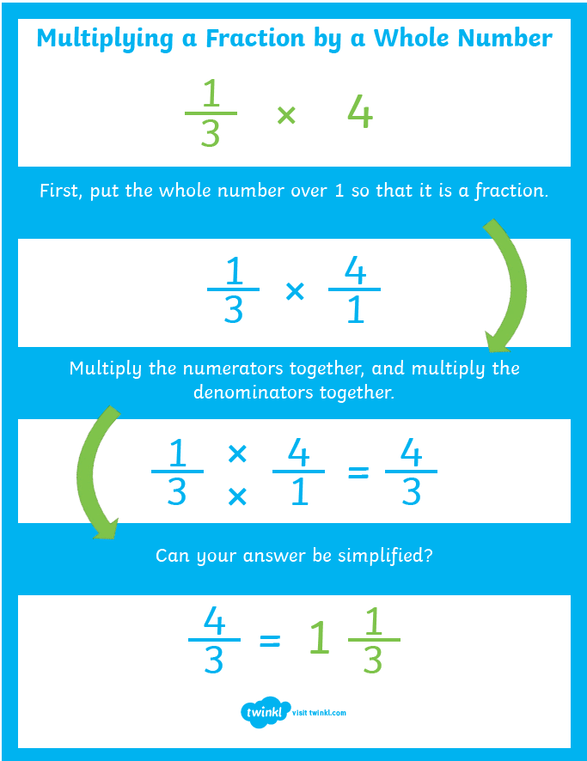
Multiplying a Fraction by a whole number

Slide 24
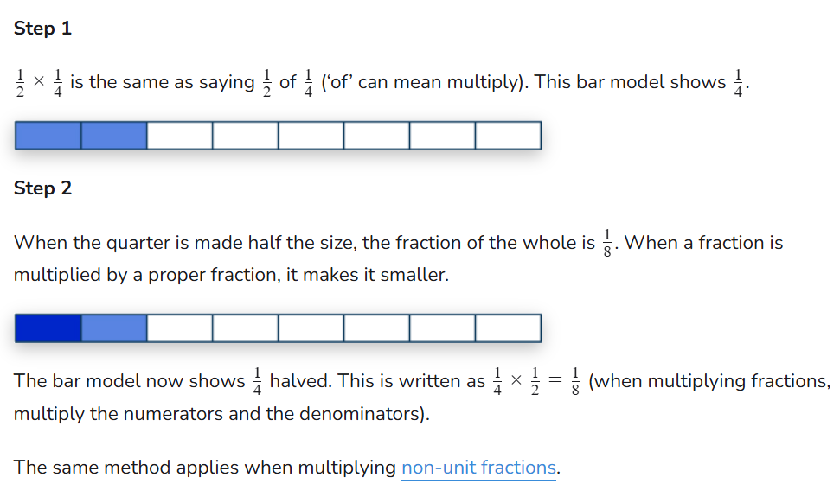
Multiplying two fractions

Slide 25


