Slide 1
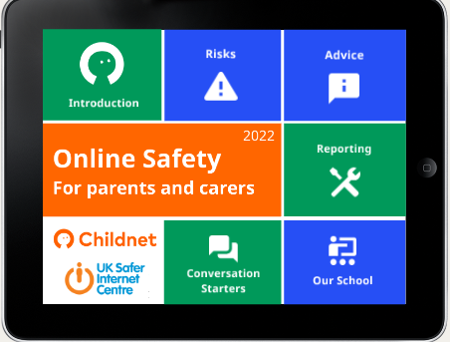

Slide 4
PEGI 3 | The content of games with a PEGI 3 rating is considered suitable for all age groups. The game should not contain any sounds or pictures that are likely to frighten young children. A very mild form of violence (in a comical context or a childlike setting) is acceptable. No bad language should be heard.
PEGI 7 | Game content with scenes or sounds that can possibly frightening to younger children should fall in this category. Very mild forms of violence (implied, non-detailed, or non-realistic violence) are acceptable for a game with a PEGI 7 rating.
PEGI 12 | Video games that show violence of a slightly more graphic nature towards fantasy characters or non-realistic violence towards human-like characters would fall in this age category. Sexual innuendo or sexual posturing can be present, while any bad language in this category must be mild.
PEGI 16 | This rating is applied once the depiction of violence (or sexual activity) reaches a stage that looks the same as would be expected in real life. The use of bad language in games with a PEGI 16 rating can be more extreme, while the use of tobacco, alcohol or illegal drugs can also be present.
PEGI 18 | The adult classification is applied when the level of violence reaches a stage where it becomes a depiction of gross violence, apparently motiveless killing, or violence towards defenceless characters. The glamorisation of the use of illegal drugs and explicit sexual activity should also fall into this age category.

Slide 5
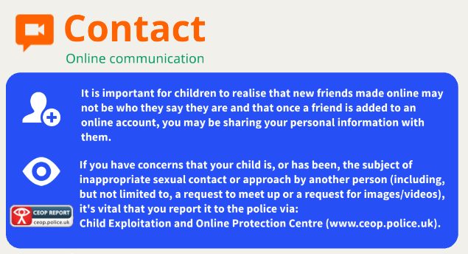

Slide 9
95% of teens are online, and the vast majority access the internet on their mobile device, making it the most common medium for cyber bullying.
23% of students reported that they’ve said or done something mean or cruel to another person online. 27% reported that they’ve experienced the same from someone else.
Girls are more likely than boys to be both victims and perpetrators of cyber bullying.
Instagram is where most young people report experiencing cyberbullying
Young people who experience cyberbullying are at a greater risk than those who don’t for both self-harm and suicidal behaviours.
60% of young people have witnessed online bullying. Most do not intervene.
Only 1 in 10 victims will inform a parent or trusted adult of their abuse.

Slide 10
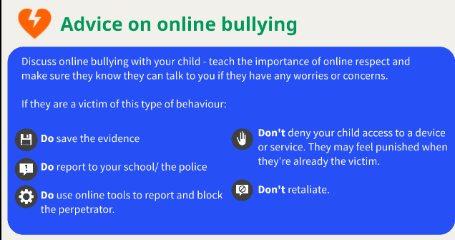

Slide 11
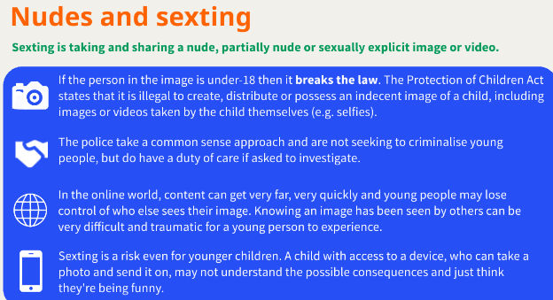

Slide 12
The Internet Watch Foundation reported that self-generated sexual imagery of children aged between seven and ten years old has increased three-fold, making it the fastest growing age group. In 2020, there were 8,000 instances; in 2021 there were 27,000 – a 235% increase. "The digital age has offered new, and previously inconceivable, ways for children to be harmed – both by adults and by other young people."

Slide 14
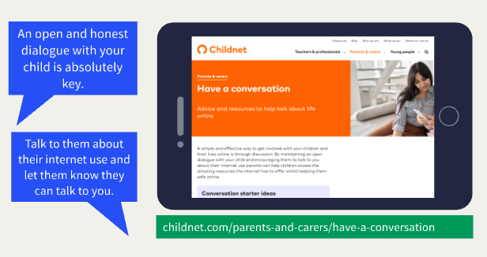

Slide 16
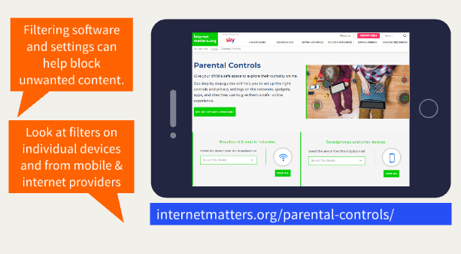

Slide 17
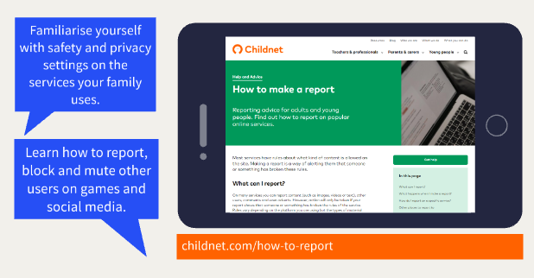

Slide 19
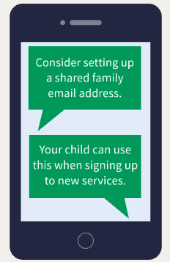

Slide 21
Conversation starters

