Slide 1
December
2023

Slide 2
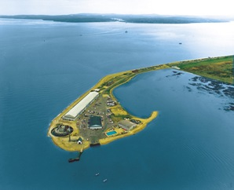
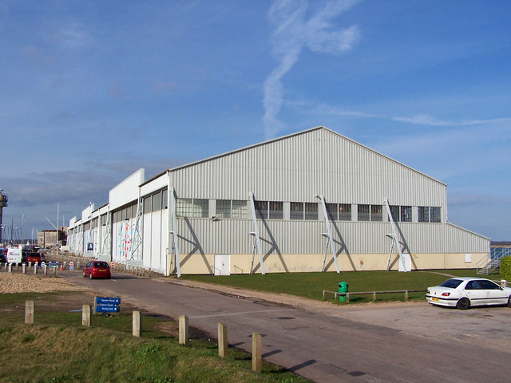
Calshot Activity Centre is roughly an hour away from Mill Rythe Junior School near Southampton.
Many of the activities are based in old air craft hangers.

Slide 3
The ‘Average’ Day:
7.15 Get up and get ready for the day.
7.45 Breakfast
9.00 Activity 1 (forest orienteering)
10.45 Morning Break (get a drink and a biscuit)
11.00 Activity 2 (forest orienteering )
12.45 Lunch
1.45 Activity 3 (Climb 1)
3.30 Break
3.45 Activity 4 (Ski 1)
5.30 Dinner
7.00 Evening Activity (Rushing rockets)
8.30 Back to the accommodation block
9.30 Bed time

Slide 4
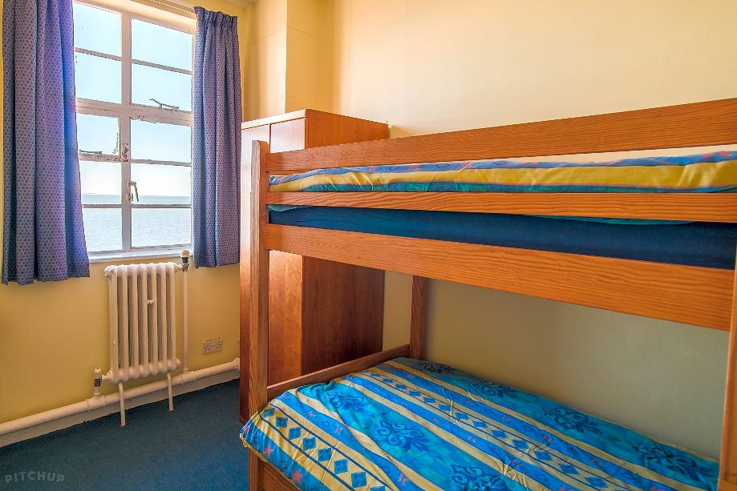
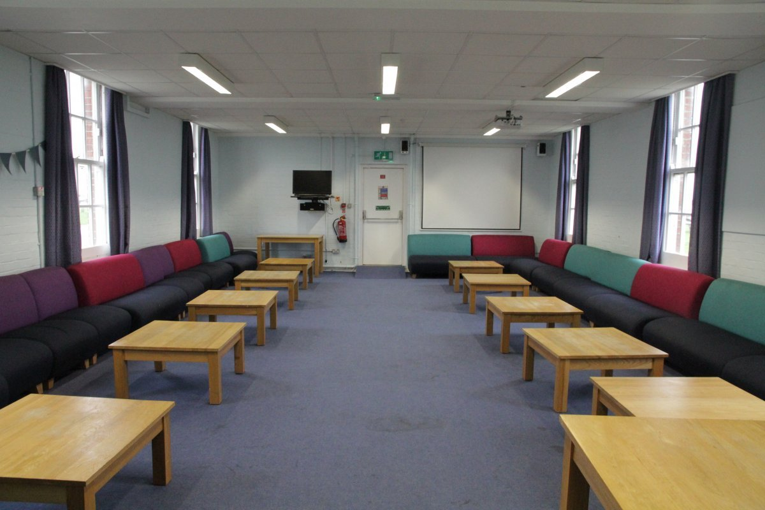
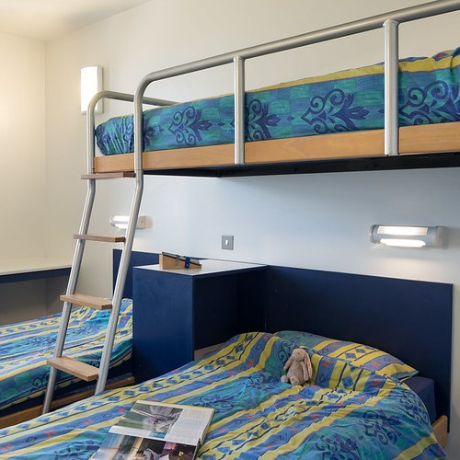
Accommodation & wash facilities
Accommodation varies depending on group size and ratio of boys to girls..

Slide 5
Groups & Instructors
Day groups are roughly split into groups of around 8-10 children. One adult from school will be assigned to this group and they will have one instructor (in most cases) for the duration of the week across the different activities.
Instructors at Hampshire Outdoor Centres are highly experienced and undergo rigorous training to ensure the physical and emotional safety of participants.
All centres operate a ‘Challenge by Choice’ ethos. Instructors will encourage students to extend themselves and focus on working effectively with others. No one will ever be forced to take part.

Slide 6
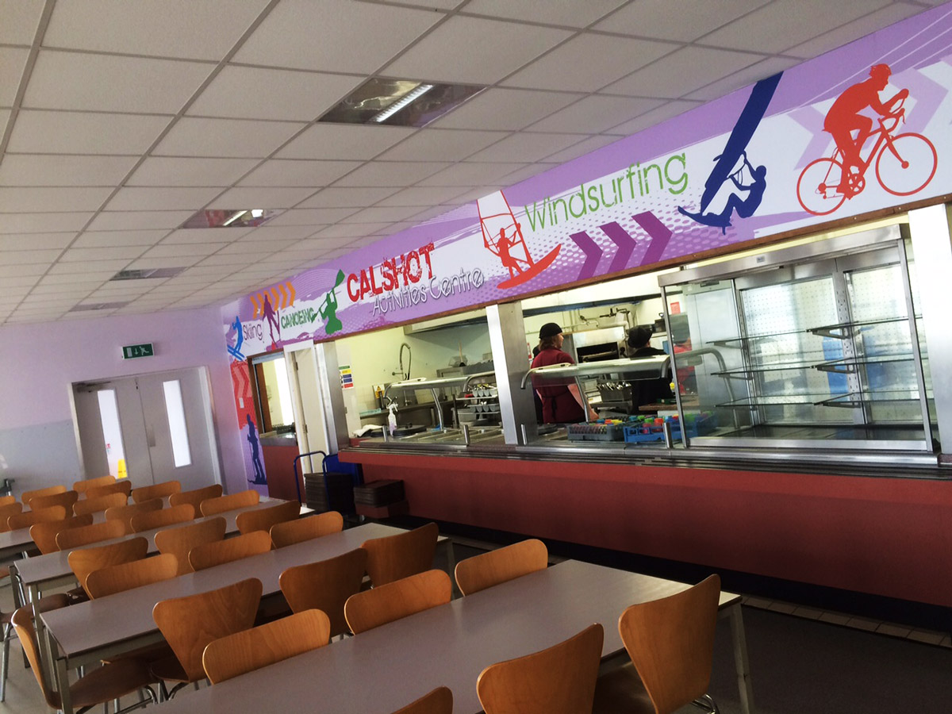
Food
Children have opportunity to have three cooked meals a day as well as snacks and drinks throughout the day.
At breakfast, toast, jams, marmite, cereals, yoghurts & fresh fruit are available in addition to the cooked choices.
At lunchtime & dinner time, there is a salad bar available in addition to the hot choices that normally includes cheese, ham slices along with salad items.
Jacket potatoes are normally available as an alternative to the main choices.

Slide 7
Medical or other concerns
We have dealt with all sorts over the years.
Some of you may have particular concerns about your child. Please just make us aware – finding out a child sleepwalks after they have selected the top bunk, or has night terrors and is in a room with the most nervous child in the year group is not helpful! An online medical form will be sent out to you prior to the trip for you to complete detailed instructions for us.
There will be ample time to accommodate these things but if you have a particular concern that is affecting your decision then please email the school and someone will be able to contact you to discuss.

Slide 8
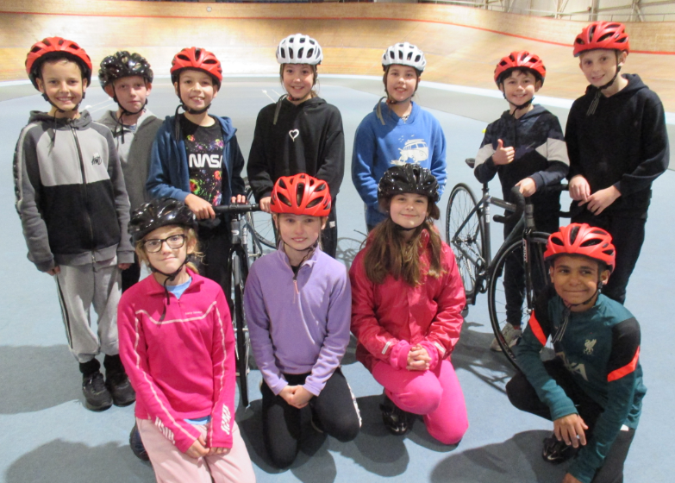
The Activities:

Slide 9
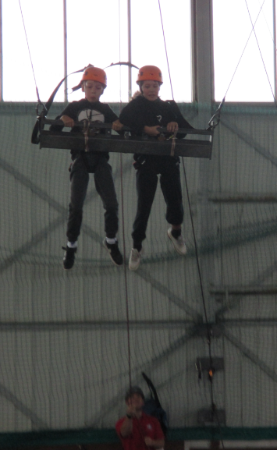
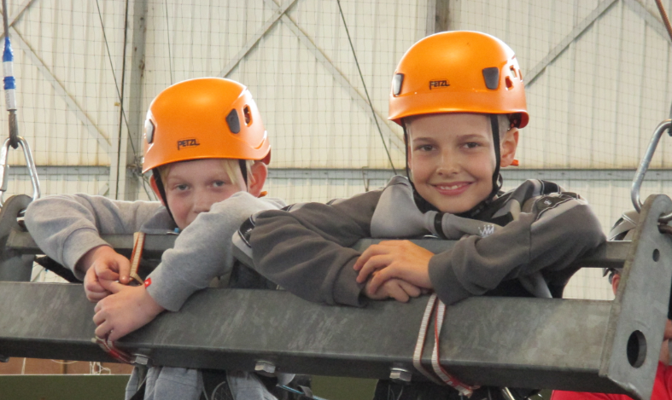
Team Swing
The activities are led by Calshot Activity Centre staff who are fully trained and qualified to lead children.
Staff from the school are with each group in a supporting role.

Slide 10
Archery

Slide 11
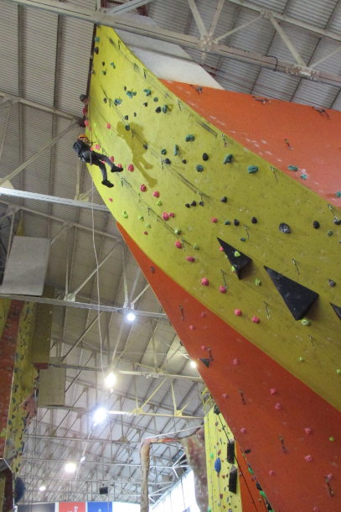
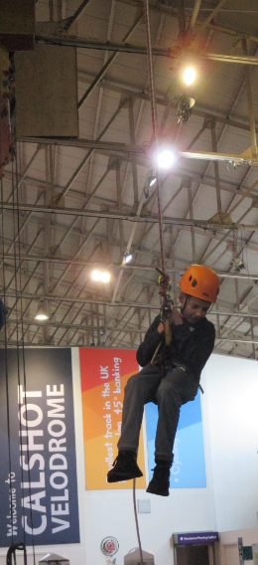
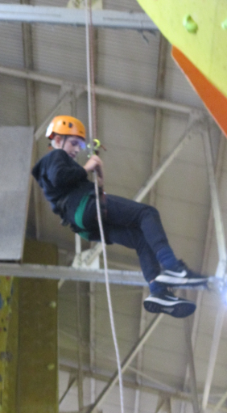
Abseiling

Slide 12
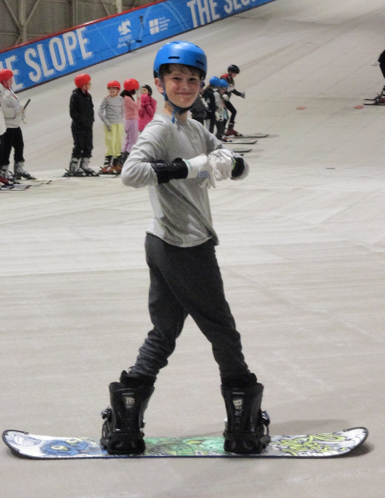
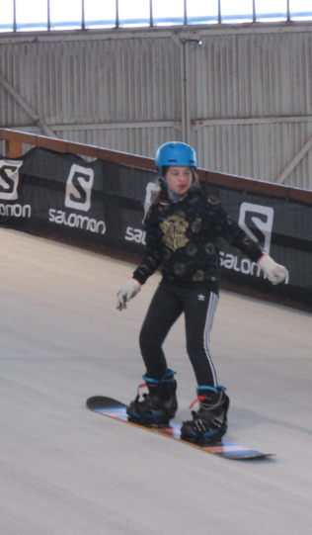
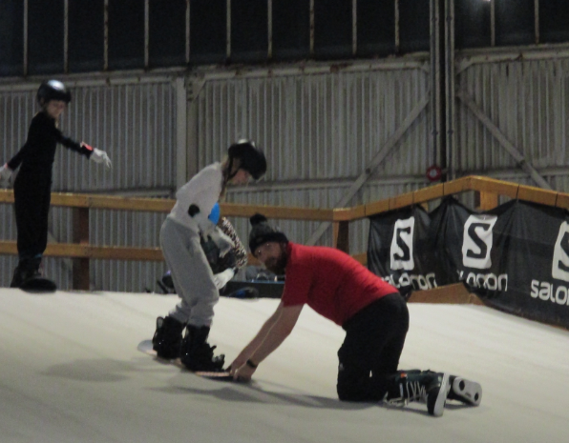
Snowboarding (new 2022)

Slide 13
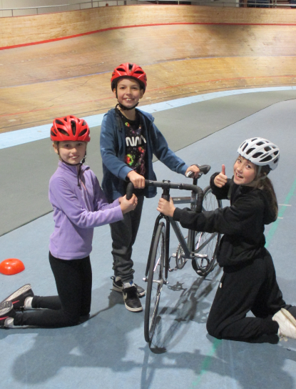
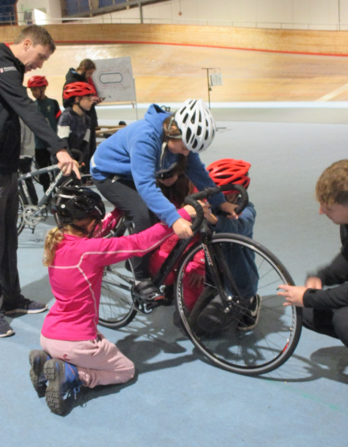
Cycling in the Velodrome

Slide 14
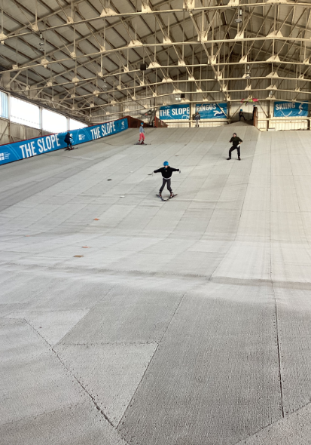
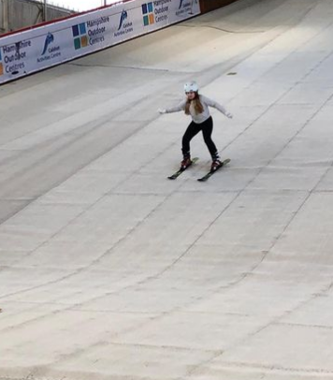
Skiing

Slide 15
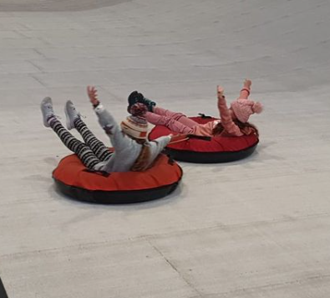
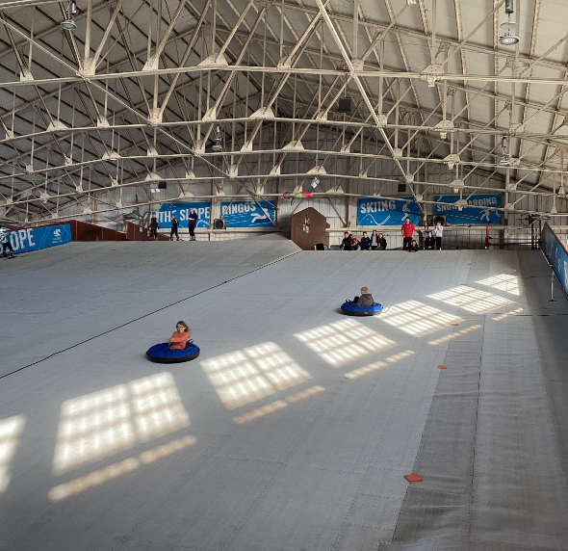
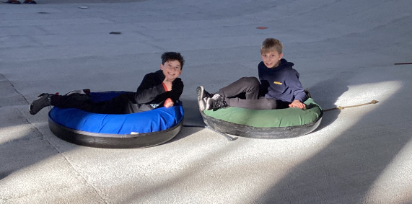
Ringos

Slide 16
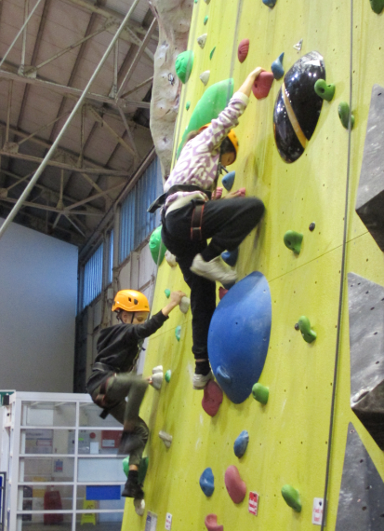
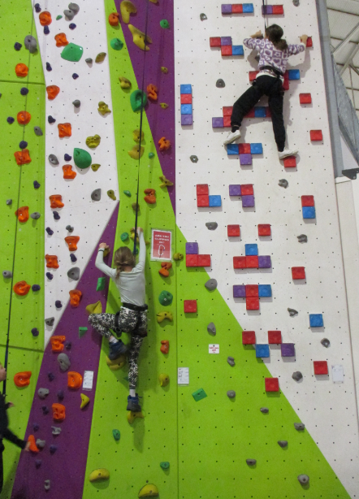
Climbing

Slide 17
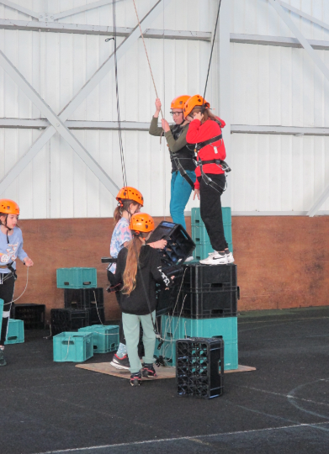
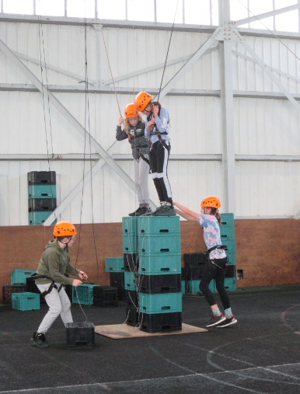
Crate Stack

Slide 18
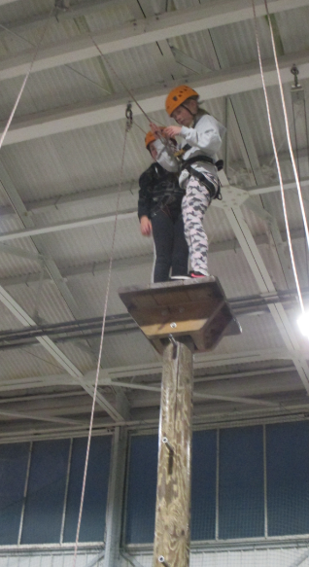
Peg Pole (new 2022)

Slide 19
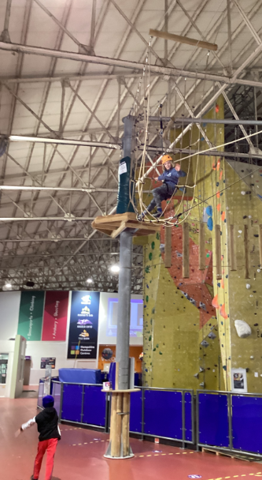
High Ropes (new 2022)

Slide 20
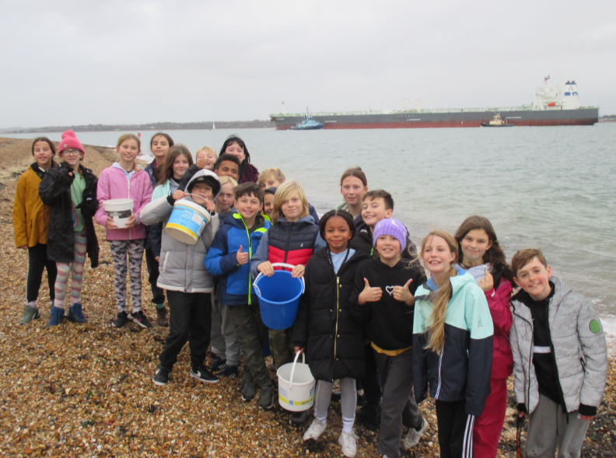
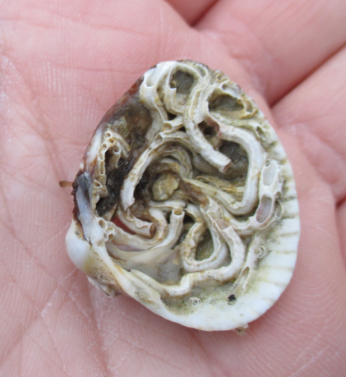
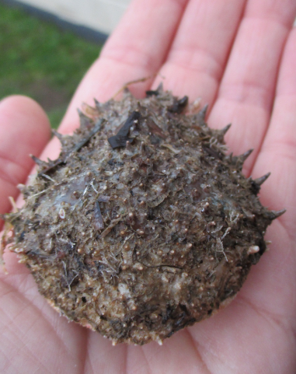
Beach visit & explore

Slide 21
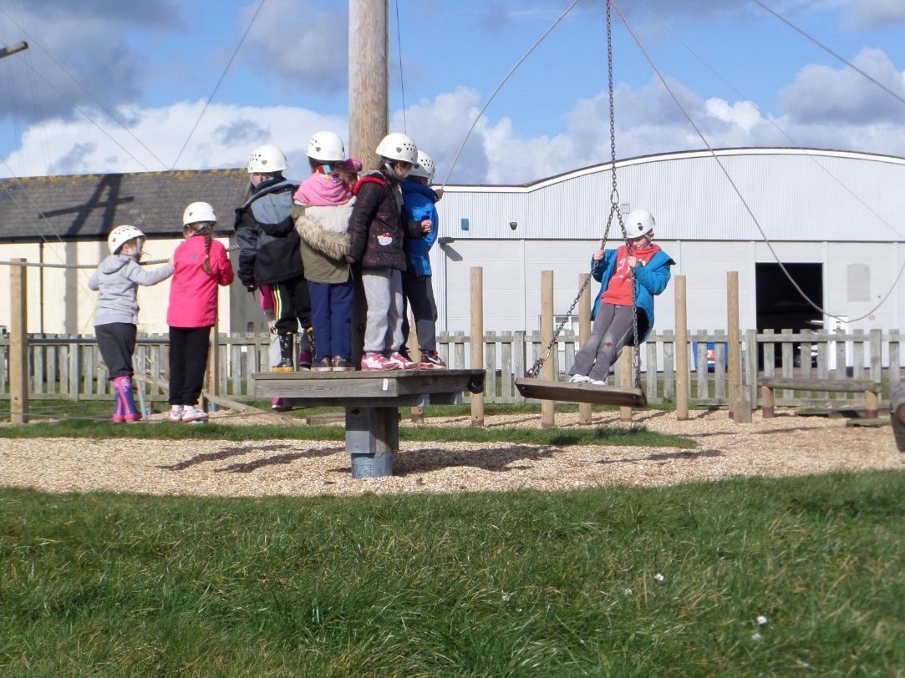
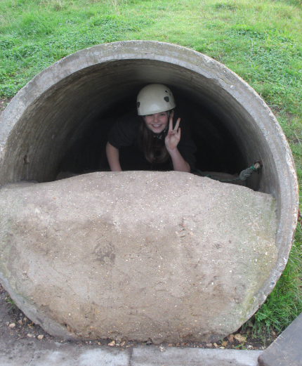
Team building & problem solving activities

Slide 22
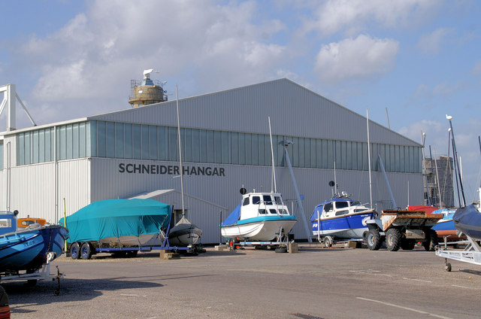
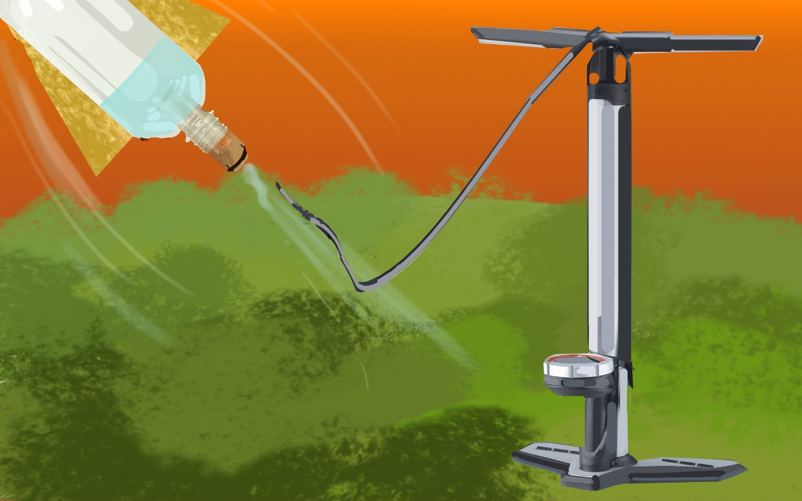
Evening Activities
We normally have a movie night on the last evening so children can relax together- and also because the children are exhausted!

Slide 23
Clothes: The activities are all very active so please don’t send your child with lots of new clothes! They do need lots of layers, warm clothes, a waterproof coat, gloves, a hat, wellington boots if possible and trainers.
Gift Shop: There is a small gift shop. It only sells a limited range of small items ranging from £1 for rubbers and pens to £5+ for a small teddy bear/ insulated mug.

Slide 25
