Slide 1
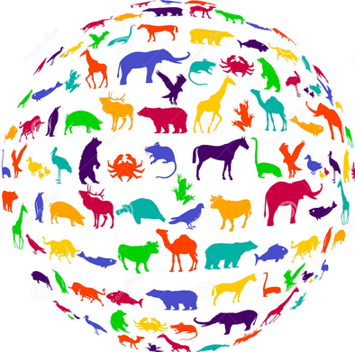
Classify different animals using pictures

Slide 2
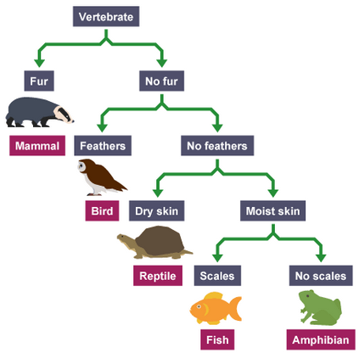
What do we mean my classification?
The arrangement of animals and plants in groups according to their similarities.

Slide 3
Why do we classify animals and plants into groups?
Scientists believe there may be as many as 10 million different animal species on Earth. When studying their lives and behaviours, it is important to have narrowed them down into different groups so that they can be researched easily.

Slide 4
How to classify animals?
There are lots of different ways we can classify animals.
It can be as simple as grouping them into –
4 legs or less and more than 4 legs.
We need to think about the things that make these animals similar and different.

Slide 5
Are they a mammal?
Yes
No

Slide 6
Are they a mammal?
Yes
No
Are they a carnivore?
Are they a bird?
Yes
No
Yes
No

Slide 7
Are they a mammal?
Yes
No
Are they a carnivore?
Are they a bird?
Yes
No
Yes
No

Slide 8
When grouping animals they don’t need to be grouped individually but they do need to be in a small enough group that you can easily see their similarities.
Using the cards can you see how many ways you can group the different animals. Can you give reasons for your groupings?

Slide 9
Classification Game
http://www.oum.ox.ac.uk/thezone/animals/animalid/games/animal2.htm
Can you drag the animals to the correct group?

