Slide 1
Design a safe environment for a hedgehog.

Slide 2
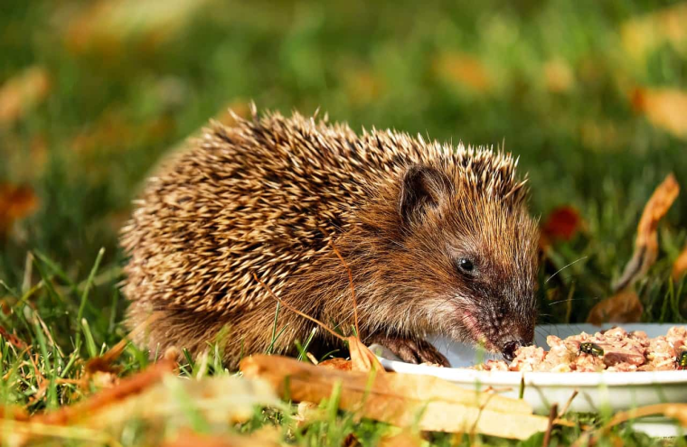
About Hedgehogs
Hedgehogs are nocturnal which means that they sleep during the day and come out at night. They will move around at night to find food and places to live.

Slide 3
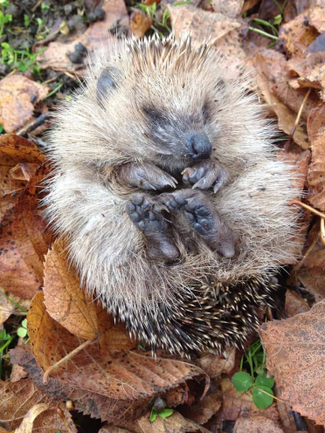
Where do they live?
Hedgehogs used to live mainly in woodland areas. However now they also like to live in our gardens near hedges for protection.
A summer nest can be a pile of loose leaves under a hedge or shrub in a quiet corner.
During the winter they nest closer to the root of a shrub or hedge with leaves, grass and twigs dragged in.

Slide 4
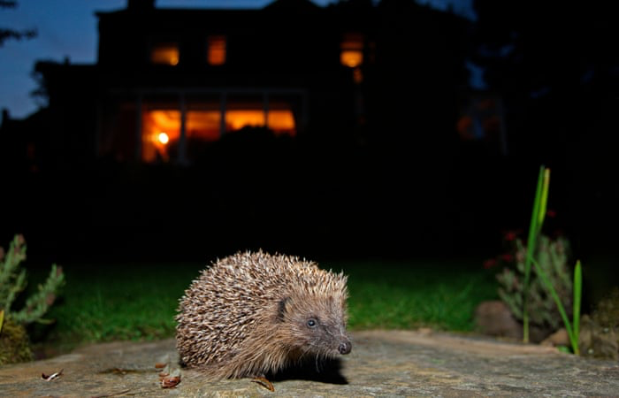
What has changed?
It is getting harder and harder for hedgehogs to find safe places to live. Some hedgehogs now even live in the cities because they can’t find woodland to build their homes.
Can you help design a hedgehog house to keep them safe?

Slide 5
What do we need to think about?
It needs to be quiet for the hedgehog so they can sleep soundly during the day.
The hedgehog needs to be able to get in and out of the house easily so they can move around at night.
Hedgehogs like to live in corners near hedges or shrubs to keep them safe.
It needs to protect them from the weather.

Slide 6
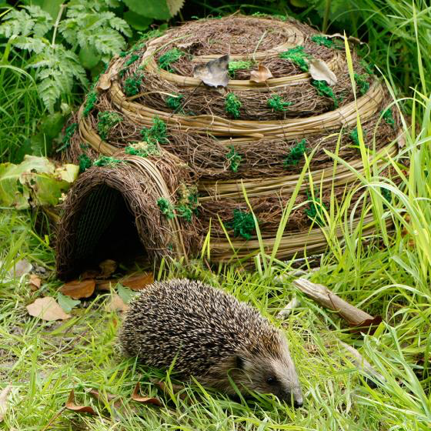
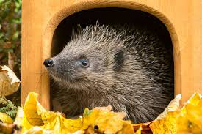
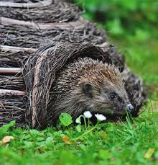
Can you design a house to protect the hedgehogs?
What shape will it be? Why?
What colour will it be? Why?
Where will the house be placed? Why?
What objects could you use to make your hedgehog house?

