Slide 1
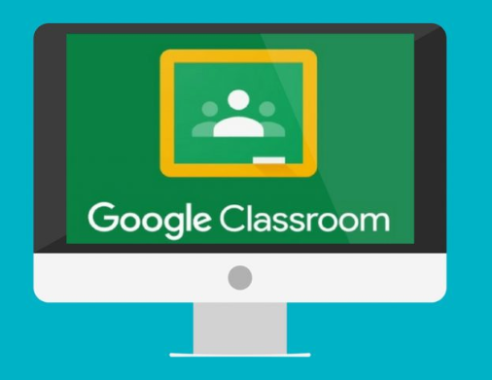
Google Classrooms A guide for parents

Slide 2
How to log in to Google classrooms. Click play on the video below.

Slide 3
Entering the classroom and the stream.

Slide 4
Accessing classwork

Slide 5
Completing the work and submitting it.

Slide 6
Different ways to submit work

