Slide 1
Mill Rythe Junior School
Special Educational Needs and Disabilities Information Report
We are a larger than average mainstream junior school on Hayling Island.
At Mill Rythe Junior School we believe that all children should be given the support needed to achieve to their fullest potential and leave us ready to enter the next part of their education journey. We believe in removing any potential barriers to learning so that children can achieve and succeed.
We support children’s academic, social, communication, emotional and physical needs by personalising learning and provision for all children with Special Educational Needs and Disabilities (SEND).

Slide 2
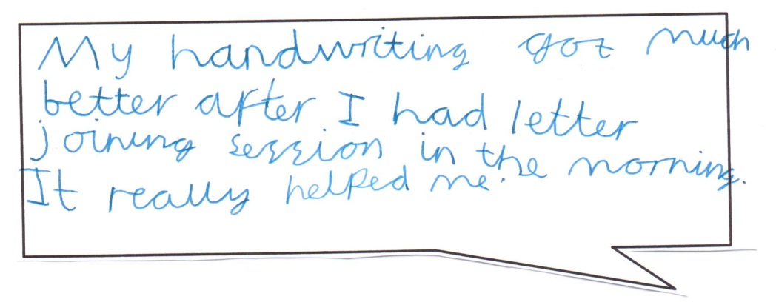
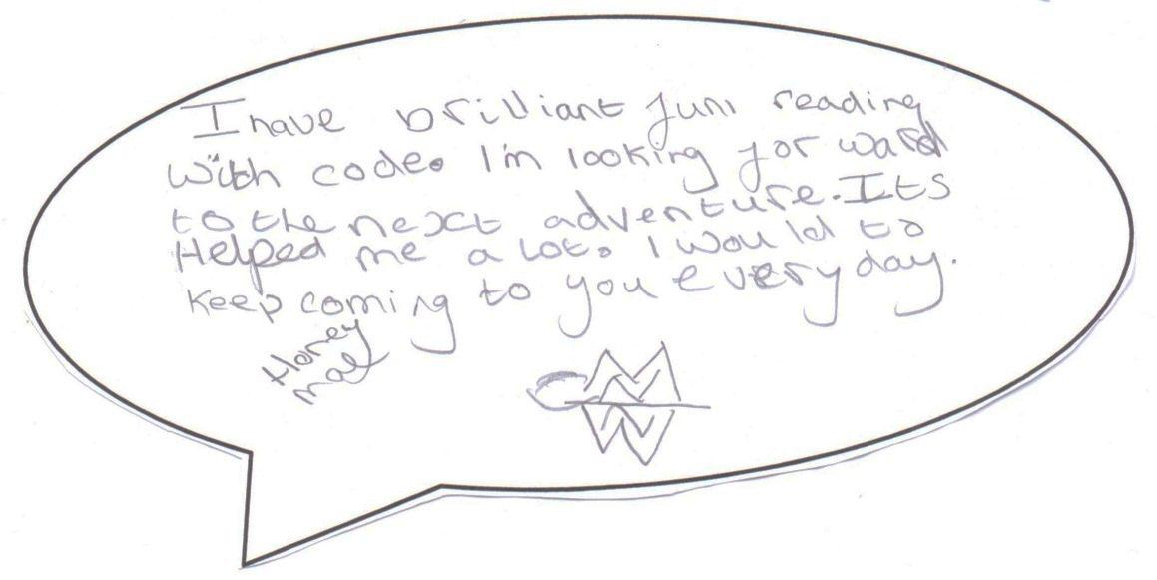
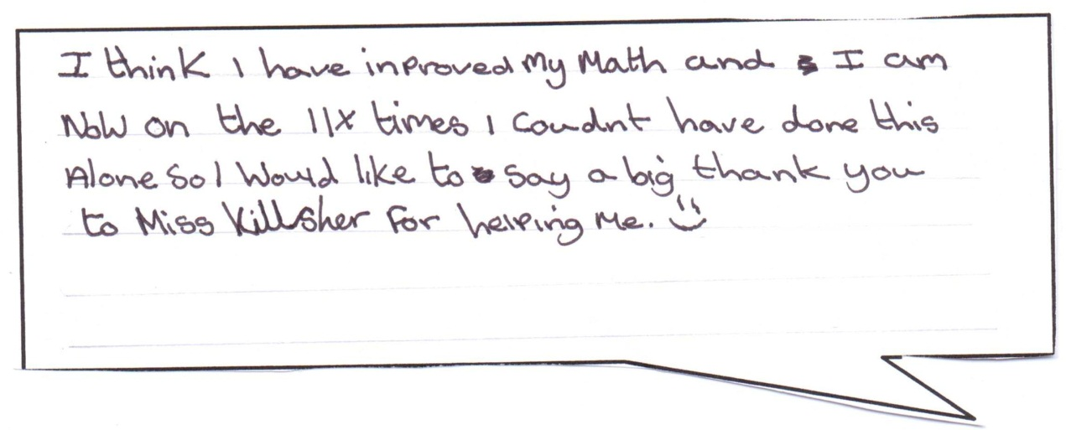
What do our children think about how we support their learning?

Slide 3
Name and contact details of the SENCo
The name of our Special Educational Needs Co-ordinator (SENCo) is Mrs Amy Ayling.
To contact our SENCo ring the school office on 02392463663 and our office staff will either arrange a meeting for you or pass on your details to the SENCo so she can call you back.

Slide 4
Key questions
The rest of the report will answer the questions below:
1) How does your school know if children need extra help?
9) What support will there be for my child’s overall wellbeing?
10) What training is provided for staff supporting children with SEND?
11) How accessible is your school?
12) How are parents currently involved in your school?
2) What do I do if I think my child has special educational needs?
3) How will both you and I know how my child is doing?
4) How will you help me support my child’s learning?
5) How will the school’s staff support my child?
6) How will the curriculum at your school be matched to my child’s needs?
7) How is the decision made about the type of and how much support my child will receive?
8) How will my child be included in activities outside the school classroom?
13) What steps should I take if I have a concern about the school’s SEND provision?
14) What special services are available at or accessed by the school?
16) Where can I get further information about services for my child?
15) How will the school prepare and support my child during transition periods?

Slide 5
1) How does your school know if children need extra help?
We carefully monitor the progress of all children on a day to day basis and by the use a number of summative assessments throughout the year.
When a particular need is identified through these assessments and observations the SENCo may conduct further testing to get a clearer picture of your child and their special educational needs.
Regular communication with parents and taking parent’s views into account is another important factor in determining whether or not a child needs extra help in school.
We liaise with both infant schools on Hayling Island and any other feeder schools to ensure that we are aware of all additional needs before a child starts at our school.
The teachers liaise with the SENCo when they feel extra support is needed.
We seek and respond to advice from outside agencies when a specialist’s knowledge is required.
The SENCo uses Hampshire guidance and criteria to decide if children need to be placed onto the school’s Special Educational Needs register.

Slide 6
2) What do I do if I think my child has special educational needs?
We encourage parents to speak to their child’s class teacher and/or the SENCo to raise any concerns.
These discussions can take place during routine meetings (e.g. parents evenings, Pupil Passport meetings and Education, Health and Care Plan annual reviews) or you can make an appointment to meet with your child’s class teacher or the SENCo at any time via the school office.
A good working relationship and regular communication between teacher and parent means we can personalise learning to meet all your child’s needs.

Slide 7
3) How will both you and I know how my child is doing?
The progress of all children is closely monitored by the class teacher. Teachers get feedback from children on a daily basis and use this to inform their lesson planning.
During the course of the year we use more formal assessments to monitor the progress they are making against the curriculum content and age-related expectations. These assessments help use to identify the progress each child is making. These are then discussed with parents through parent evenings and school reports.
In addition when considering your child’s academic needs we use a range of tests to monitor their progress and evaluate the effectiveness of the Special Educational Needs programmes we use with them. The SENCo meets with teaching assistants to discuss the progress of children on Special Educational Needs programmes and ensure any adjustments needed are made to fit the needs of the individual child.
Continued…

Slide 8
3) How will both you and I know how my child is doing?
For other needs (such as social or emotional) we will use other monitoring methods such as observations and tally charts to track your child’s progress.
In some cases progress is monitored and/or tested by outside agencies (e.g. tests conducted by Speech and Language Therapists).
Pupil passport targets will be monitored in class and progress towards these recorded on your child’s pupil passport.
The progress your child is making will be discussed with you during pupil passport meetings. If you would like to know earlier, please contact us.
Education, Health and Care Plan targets will be reviewed at annual review meetings and a discussion will be held between us as to the best way to continue to support your child.
Every term we have a celebration assembly for all children on the SEN register. During this assembly children will be given a certificate to acknowledge the progress they have made that term. Parents are invited to come along to these assemblies and the SENCo will be at hand for any questions.
All children on the SEN register have a separate page in their annual report detailing progress made throughout the year in any interventions they have had.

Slide 9
4) How will you help me support my child’s learning?
We share your child’s progress with you during parents evenings and school reports and would be happy to suggest ways in which you can support your child at home.
We will meet with you three times each year at your child’s pupil passport meetings to update you on their progress and share their new targets with you.
Children with an Education, Health and Care plan (EHCP) will also have an annual review. This is a yearly meeting that enables the school, parents and any outside agencies involved to discuss your child’s progress and how we can all continue to support them.
We have a range of information leaflets for parents offering practical advice on how to support your child. These can either be collected from the school office or downloaded from our School website.
Every term we have a celebration assembly for all children on the SEN register. During this assembly children will be given a certificate to acknowledge the progress they have made that term. Parents are invited to come along to these assemblies and the SENCo will be at hand for any questions.

Slide 10
5) How will the school’s staff support my child?
Teachers: Our teachers will ensure all lessons are differentiated to meet the needs of your child. (For further details on differentiation refer to the next question.) Teachers will work with children in class on a regular basis with the aim of accelerating their learning.
Teaching Assistants: Our TAs will regularly support children with SEND in lessons. This may be on a one to one basis or via small group work. Sometimes teaching assistants work with children on a one to one basis outside of the class in order to follow specific programmes to support their learning.
Special Educational Needs Co-ordinator: The SENCo will monitor your child’s progress, seek advice from outside agencies and give suggestions to teachers on how to support your child.
Other staff: All school staff will be made aware of any significant social, emotional, communication or physical needs your child may have so that they know the best way to support your child.

Slide 11
6) How will the curriculum at your school be matched to my child’s needs?
In order for all children to achieve to their fullest potential we need to ensure they can access all lessons. We do this through adjusting our curriculum in many ways to meet their personal needs. Some of these adjustments are:
Setting differentiated learning objectives
Using visual aids and practical resources selected at an appropriate level
Use of alternative means of recording ideas
Specialist equipment purchased as and when needed
Individual learning targets (on pupil passports)
Support on a one to one or small group basis from the teacher or TA
Seeking advice from specialist as and when needed
Pre-learning and over-learning of key vocabulary and concepts

Slide 12
7) How is the decision made about the type of and how much support my child will receive?
The SENCo will use formal assessments, teacher recommendations, parental concerns, specialist advice and observations of your child to decide what support is needed and how often this support this needed. Hampshire Local Authority criteria outlining best practice will be referred to with the aim to put the right level of support in place based on the knowledge of each child’s unique set of strengths and needs. This will be shared with you through pupil passport meetings.
This support may be in the form of:
Intervention programmes (reading, writing or maths) – Regular one to one programmes
Daily reading with an adult
Social skills
Emotional Literacy Support Assistant (ELSA) support
FEIPs (Framework for Enhanced Individal Pastoral Support)
THRIVE sessions
Speech and language support
Confidence group
Transition group
Handwriting
Motor skills (fine and gross)
Teaching assistant support in lessons

Slide 13
8) How will my child be included in activities outside the school classroom?
We believe that all children should be able to access extra curricular activities as these experiences are often the ones we remember the most from our time at school. To this end we ensure that all children access school trips, sports events, music lessons, lunchtime and access to any other clubs available. We do this by liaising with you to ensure we are catering for your child’s specific needs.

Slide 14
9) What support will there be for my child’s overall wellbeing?
At Mill Rythe Junior School we want all our children to feel happy and safe in school. To this end teachers and staff monitor children’s wellbeing and put support in place to cater for their emotional, social and communication needs.
When extra support is required, we currently have one trained Emotional Literacy Support Assistant (ELSAs) who offers support on both a short term and long term basis depending on the level of support your child needs.
We also have a FEIPS practitioner (Framework for Enhanced Individual Pastoral Support) who offers support for children on a long term basis based on their social and emotional needs.
We have a home-school link worker who is available every morning to listen to your concerns and pass on messages to the teachers.
We have a large and caring first aid team.
We have two trained speech and language teaching assistants who will work with your child to help them communicate with their peers.
We put behaviour plans and Thrive sessions in place to help those children who need this extra support.

Slide 15
10) What training is provided for staff supporting children with SEND?
All Teaching Assistants are given both in house and external training in Special Educational Needs (SEN) programmes and ways to support children with SEND. This includes training from educational psychologists, SEN experts and training in how to run specific SEN programmes.
Teachers are trained and supported by the SENCo in meeting the needs of children with SEN.
Outside agency advice and training is drawn upon where the school does not have the relevant knowledge to support a child with SEND.
Future training is decided based on the current needs of children on roll. Specific training is put in place where there is a clear need.
The SENCo has the National SENCo Award.

Slide 16
11) How accessible is your school?
The school is on one level, although there are some small steps to access key buildings. There is a ramp at the front of the school for wheelchair access and a disabled toilet situated in the school indoor swimming pool. The school has a portable hearing loop. There is a disabled parking space and the school can be accessed easily from the car park.
For information on how the school is aiming to improve please see the accessibility plan. This can be found on our school website.
Alternatively you can ring the school office on 02392463663 to discuss your personal needs with a member of our office team.

Slide 17
12) How are parents currently involved in your school?
We have a number of parents evenings/meet the teacher evenings throughout the school year for parents to meet with their child’s class teacher both formally and informally.
There will be opportunities throughout your child’s time in school to come in and watch or take part in special event days linked to current topics.
We have an annual parent survey conducted by the governing body.
Parents of children with Special Educational Needs are invited to termly pupil passport meetings and the SEN celebration assembly.
We have a number of parent volunteers who help out with school trips.
Our PTA run many events throughout the year.

Slide 18
13) What steps should I take if I have a concern about the school’s SEND provision?
If you have any concerns about the provision put in place for your child please speak to their class teacher or the SENCo. We would be happy to discuss your concerns with you and think about the best way forward to meet these concerns.
If you feel your concerns need to be taken further please see our complaints policy on our school website.

Slide 19
14) What special services are available at or accessed by the school?
Hampshire Educational Psychologist Service
Speech and language therapists
Hampshire specialist advisory teachers for Visual Impairment (VI), Physical Disabilities (PD) and Hearing Impairment (HI)
Behaviour support team
Child and Adolescent Mental Health Services (CAMHS)
Occupational Therapists
Advice from schools with specialist provision (e.g. Riverside)
Hampshire SEN services
Communication and language team (CAL)

Slide 20
15) How will the school prepare and support my child during transition periods?
We have close links to The Hayling College and both Infant schools on the island to enable a smooth transition either to our school or from our school.
Extra visits for the children who would benefit from this will be arranged. These may be on a one to one basis or a small group basis.
Discussions between the teachers and SENCos leading up to transition enables a smooth transition where children are supported and staff are made aware of how to meet the specific needs of all children with Special Educational Needs and Disabilities.
For some children who need a more detailed transition plan an Inclusion Partnership Agreement (IPA) may be written and a meeting between the relevant schools, parents and any outside agencies will take place. The aim of the meeting will be to develop a personal transition plan to ensure your child is supported in the transition from one school to another.

Slide 21
16) Where can I get further information about services for my child?
Please see Hampshire’s Local offer to find out about all the services available to you and your child in Hampshire.
http://www.hampshirelocaloffer.info/en/Main_Page

